Slide 1


.NET Core overview
Ievgen Makukh
September, 2018

Slide 2
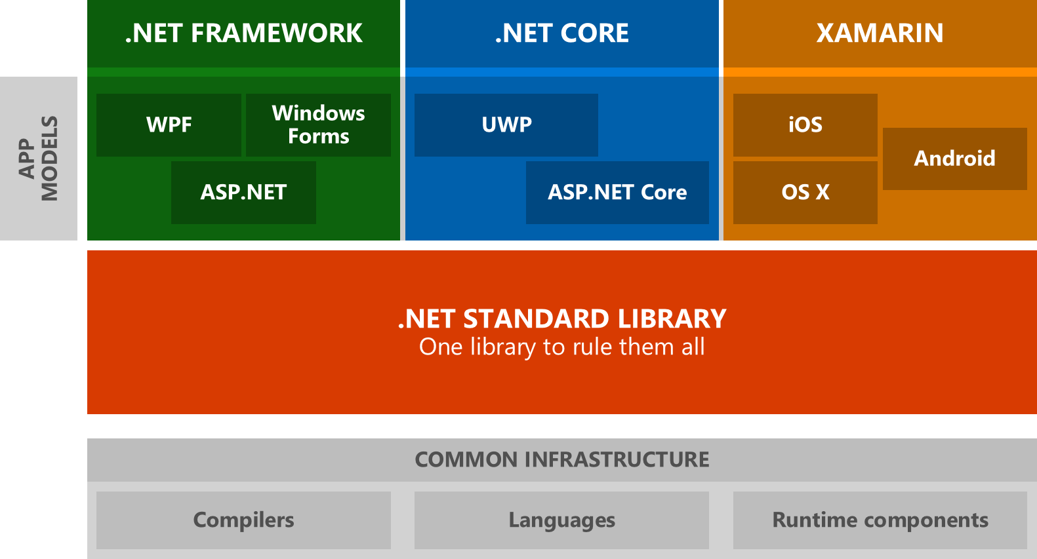
.NET core overview

Slide 3
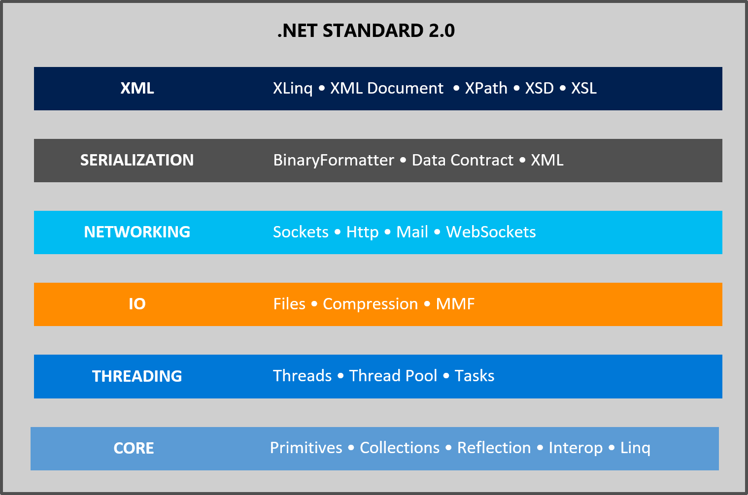
.Net Standard api

Slide 4
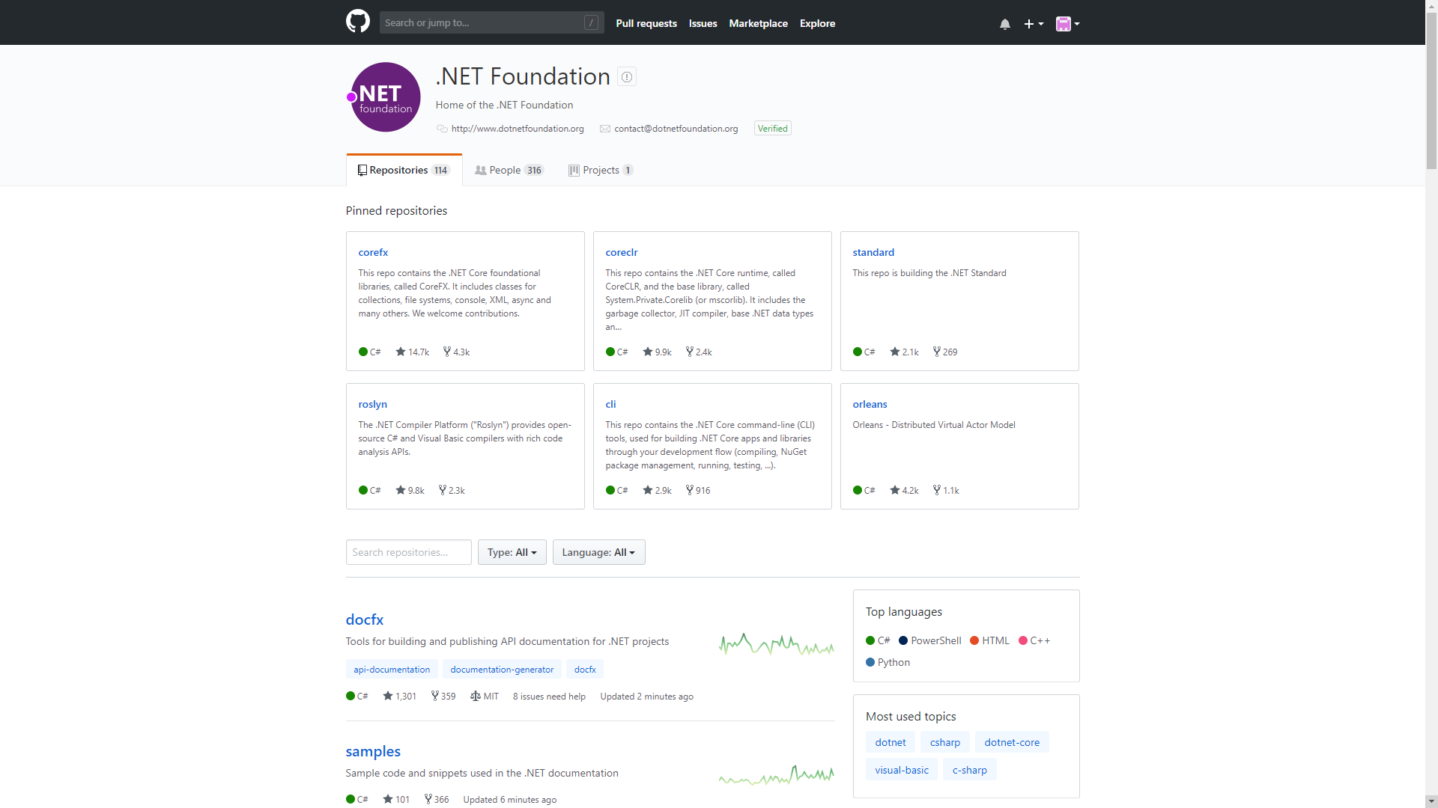
Embracing open source

Slide 5















TECHNICAL STACK

Slide 6
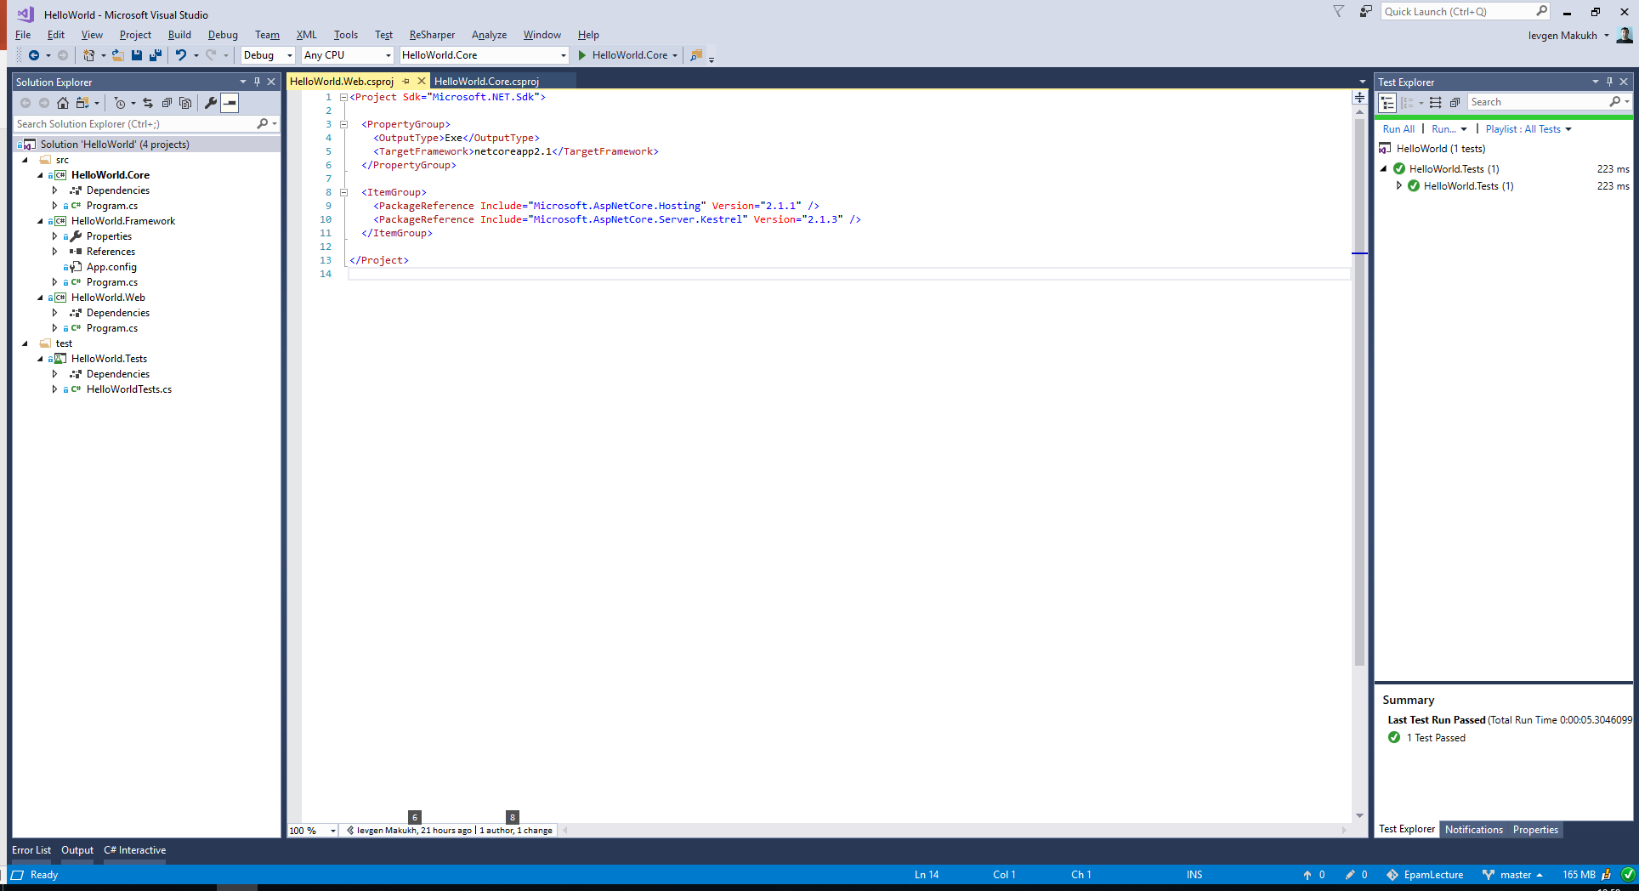
.NET CORE PROJECT STRUCTURE (DEMO 1)

Slide 7
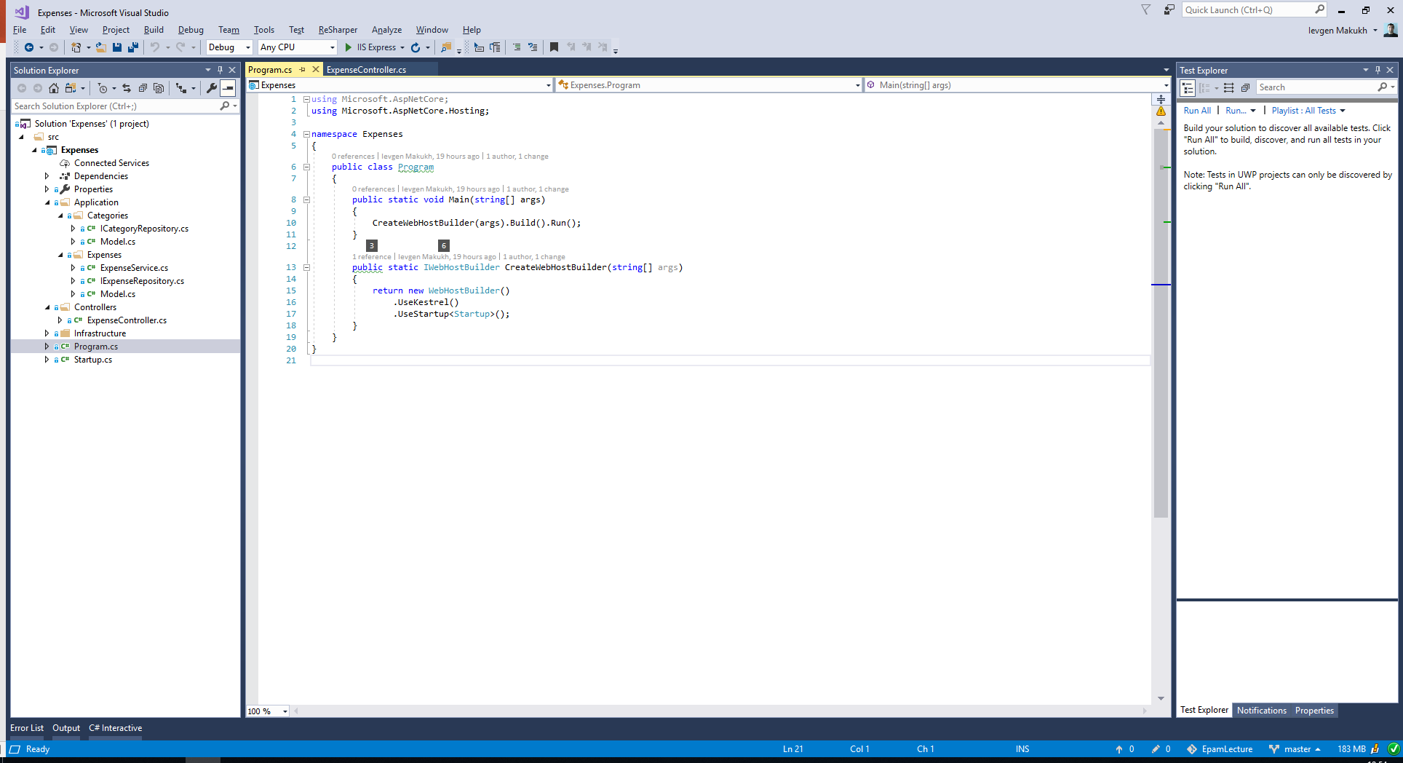
ASP.NET CORE PROJECT STRUCTURE (DEMO 2)

Slide 8
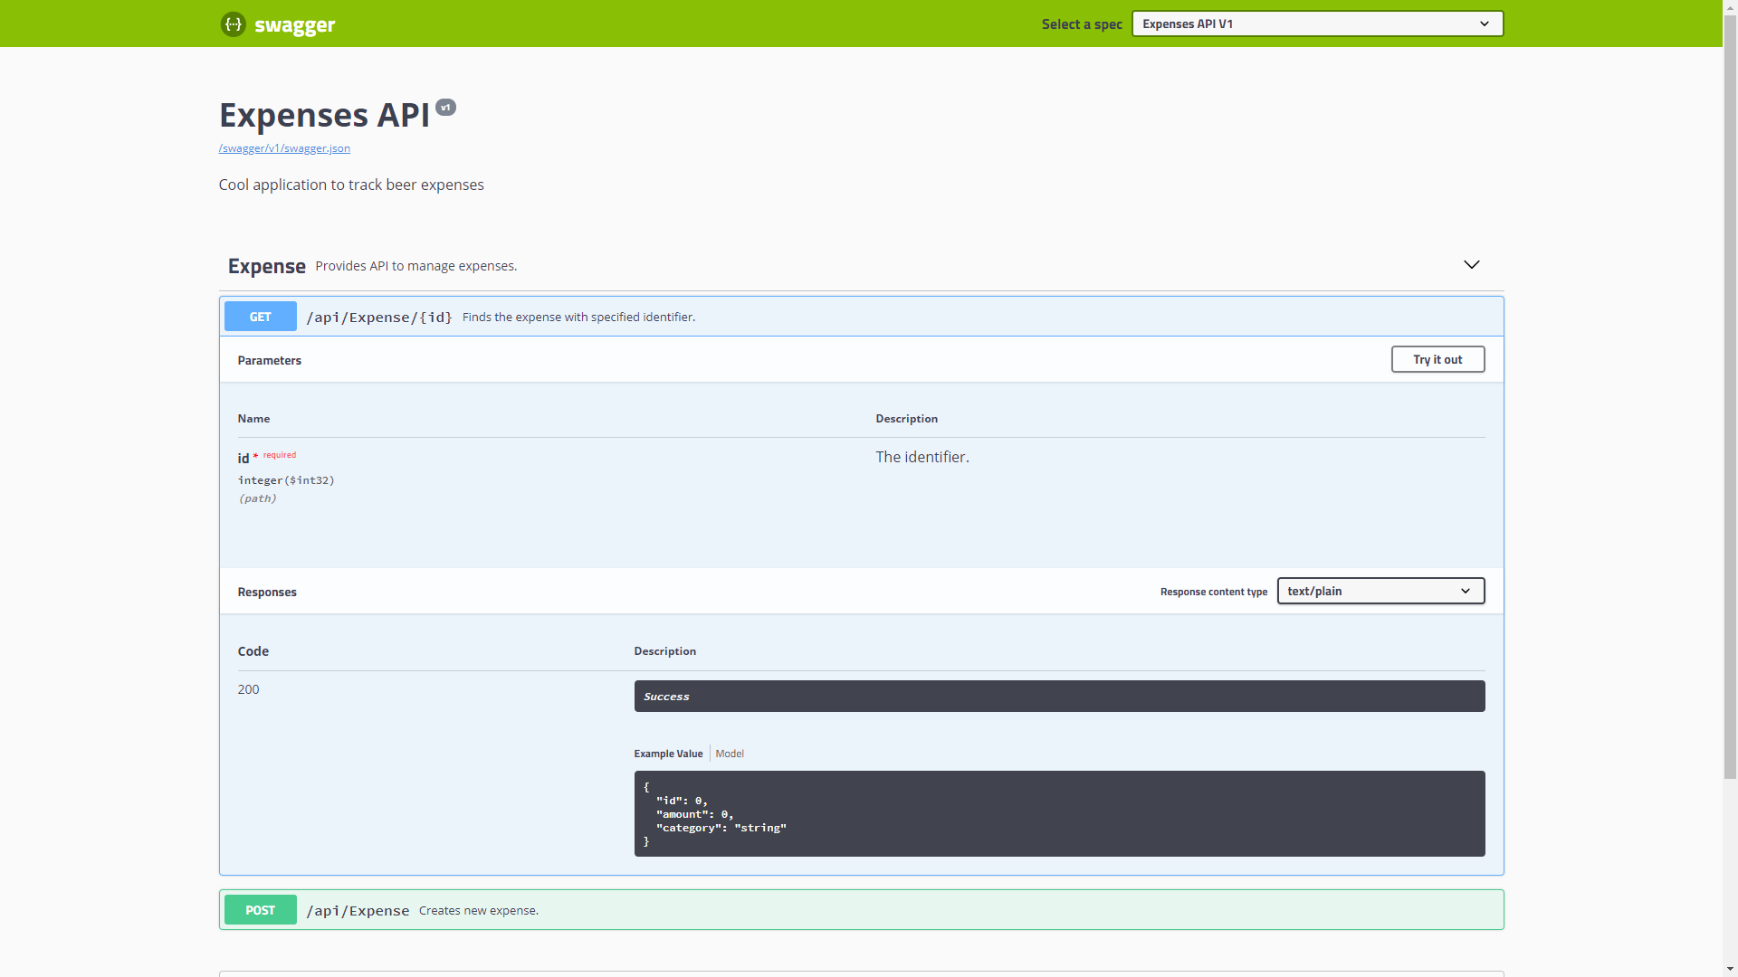
SWAGGER (DEMO 3)

Slide 9
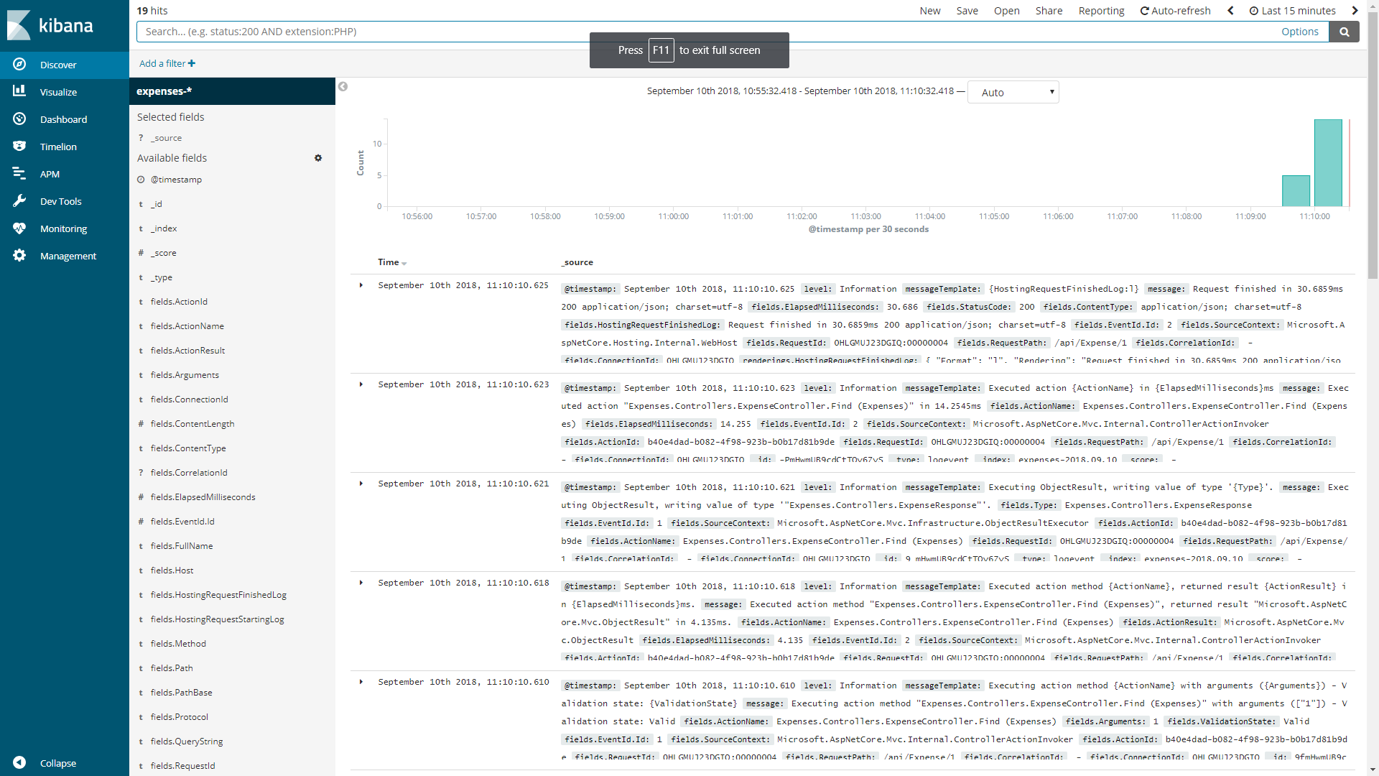
LOGGING (DEMO 4)

Slide 10
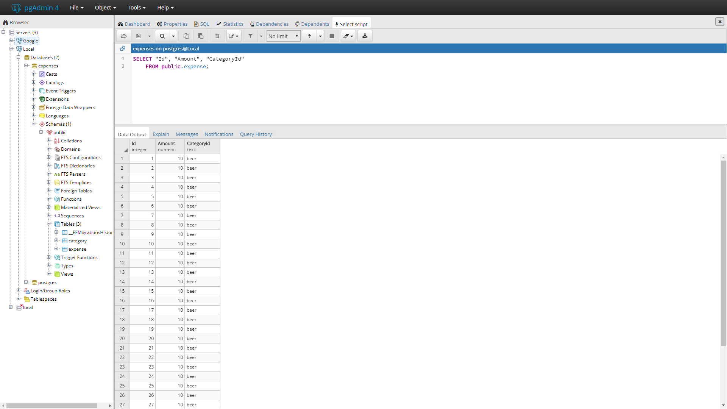
ENTITY FRAMEWORK CORE (DEMO 5)

Slide 11
Thank you
Questions

